Slide 1
Week 6
VL-Bert & R-CNN

Slide 2
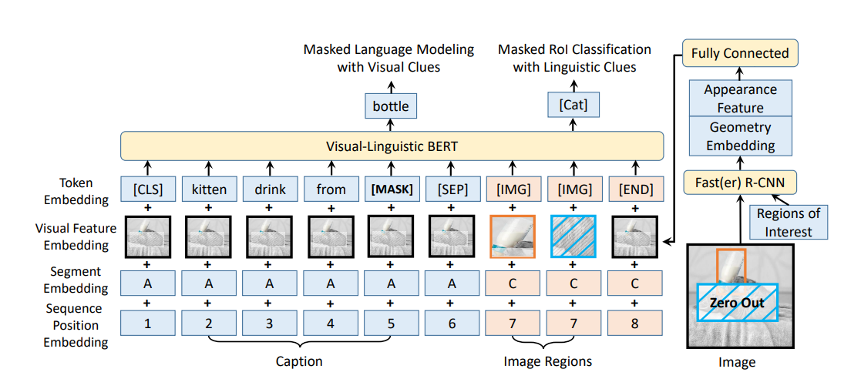
VL-Bert
Architecture
Visual Feature Embedding
Pre-training Task

Slide 3
Architecture
summary
Three type of segment: A, B, C. A and B for the words from first and second input sentence. C for the RoI of input image

Slide 4
Visual Feature Embedding
Compute geometry location relation of RoI.
For non-visual elements, the visual appearance features are extracted on the whole input image, by aping Fast R-CNN on an RoI covering the whole input image.
For the visual element corresponding to an RoI, the visual appearance feature is extracted by applying a Fast R-CNN.

Slide 5
Pre-training Task
The RoI of input image will be covered by Zero Out.
Visual Clues means the visual features of RoI.

Slide 6
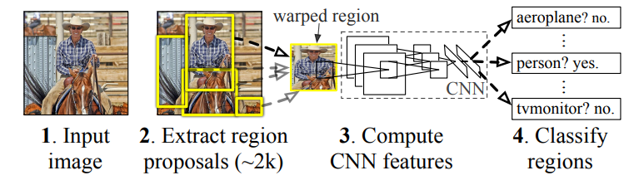
R-CNN
Selective Search
AlexNet

